Slide 1

PREDICTING ENERGY EXPENDITURES
JOSEPH ANTHONY
EVERETTE GOUGH
JOANNA LEWIS
KEISHA MALDONADO
AUSTIN MCCONNELL
MICHELE DI SANCTIS

Slide 2

OVERVIEW
The purpose of this project was to build a machine learning model that could accurately predict estimated costs and energy consumption per household based on various characteristics. Our goal is to achieve over 75% accuracy or an R2 value above 0.75.

Slide 3


DATA SOURCE
US Energy Information Administration's 2020 Residential Energy Consumption Survey
“The Residential Energy Consumption Survey is a national sample survey that collects energy-related data for housing units occupied as a primary residence and the households that live in them. We collected data from nearly 18,500 households in housing units statistically selected to represent the 123.5 million housing units that are occupied as primary residences.”
https://www.eia.gov/consumption/residential/data/2020/index.php?view=microdata

Slide 4
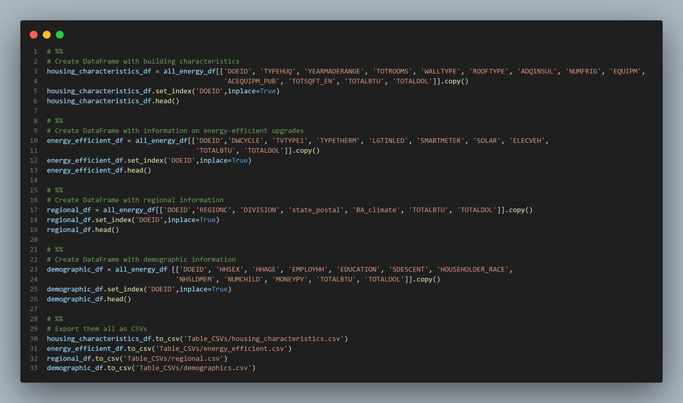

DATA CLEANING
Divided our data into 4 different categories:
Housing Characteristics
Energy-efficient upgrades
Regional Information
Demographic Information
Using Pandas, we created CSVs with columns of relevant data of each category.

Slide 5
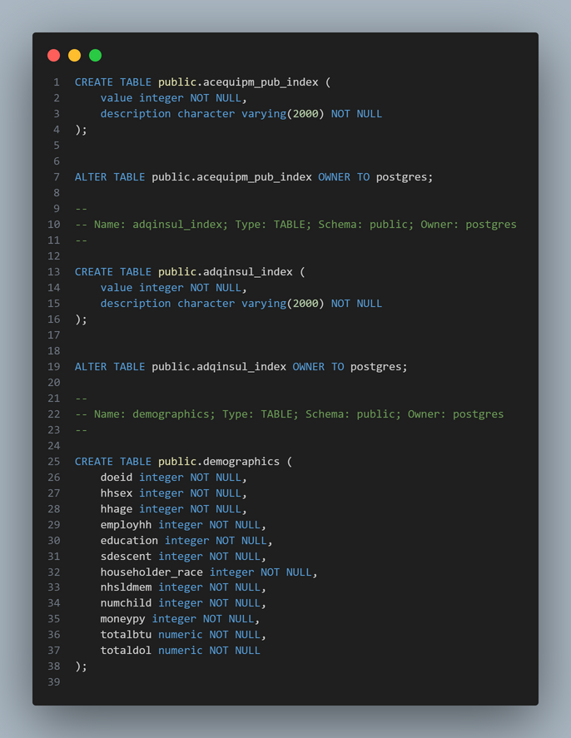
DATA STORAGE

Slide 6

Machine Learning Models

Slide 7
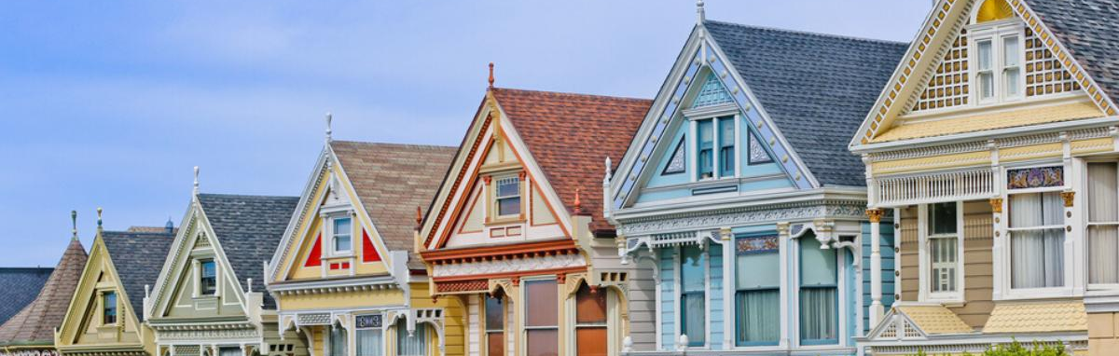
HOUSING CHARACTERISTICS
Target: Total BTU
Features: Typehuq, yearmaderange, totrooms, walltype, rooftype, adqinsul, numfrig, equipm, acequipm_pub, totsqft_en
Models: Linear Regression, Random Forest, CatBoost, LightGMB, and Deep Neural Network (Keras Sequential), Gradient Boosting
Notes:
First catergory - Housing Characteristics
Target: Total BTU or total energy usage
Features:
Type of Housing Unit (mobile home, single family house (duplex? townhome?), apartment
Year house was constructed - decade
Total # of Rooms in the home, excluding basements
Wall Type of exterior (brick, wood, siding, stucco, etc)
Roof Type
Level of insulation (self reported) Well insulated to Not insulated
# of Refrigerators used in the home (0-9)
Main space heating equipment
Main air conditioning equipment
Total energy-consuming area in square feet

Slide 8
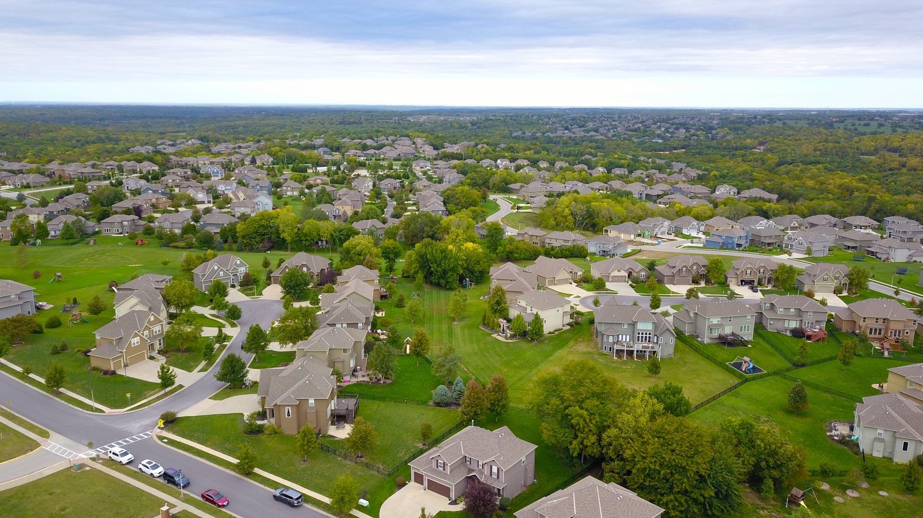
R2 = .43
Linear Regression Model
4
0.2
COEFFICIENTS
Attempts
Test Size
Optimizing Techniques
Notes:
Linear regression was used as a base line due to simplicity of model, and assumption that there would be a linear relationship between housing characteristics and total energy consumption.
Played around with testing size - no significant changes
Reviewed coefficients of each feature to find which had the strongest relationship.
Removed wall type, rooftype, heating element, and total energy consuming area, and kept year constructed, total # of rooms, level of insulation, number of fridges, and ac element. R2 value dropped to .36

Slide 9
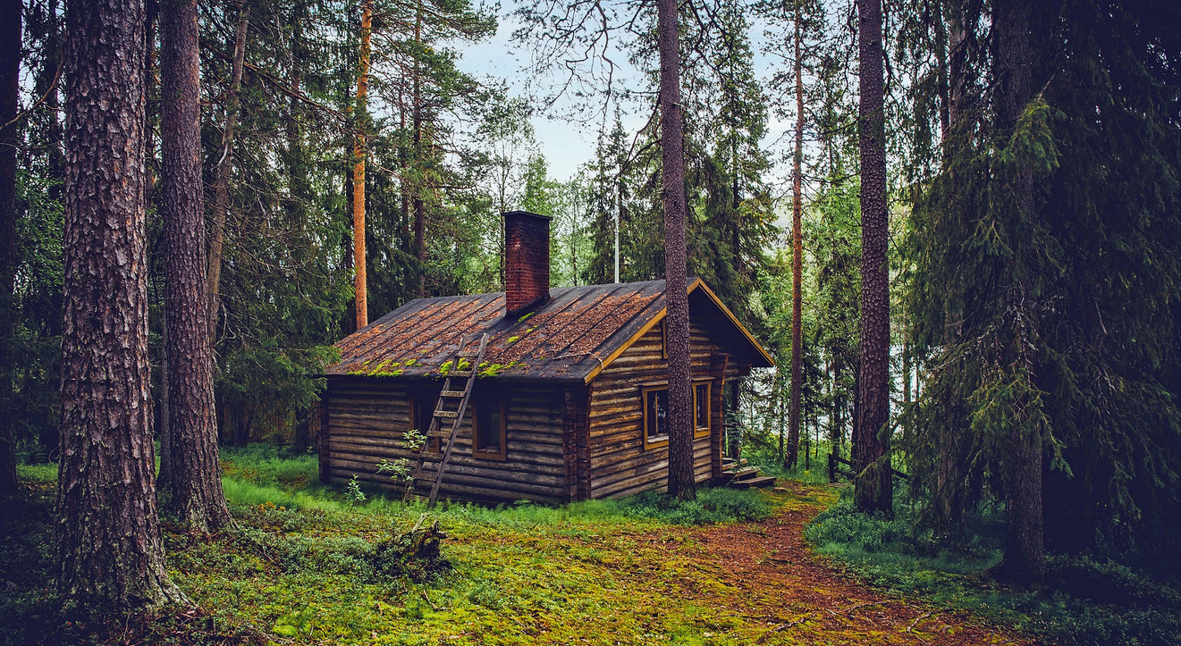
R2 = .47
Random Forest Regressor
2
100
FEATURE IMPORTANCE
Attempts
# of Decision Trees
Optimizing Technique
Notes:
Used n-estimator of 100 - no significant change in R2 value when I fiddled with number of decision trees.
To optimize - looked at feature importance. Here, heating element, total energy consuming area, year constructed, type of housing unit, and total rooms had a higher importance. All other elements were dropped, by r2 value also dropped to .37

Slide 10

R2 = .53
Gradient Boosting
2
200
GRID SEARCH
Attempts
# of Decision Trees
Optimizing Technique

Slide 11

HOUSING CHARACTERISTICS
Switched to classification models by “Binning”
*Resulting Models shown next
Target: Total BTU
Features: Typehuq, yearmaderange, totrooms, walltype, rooftype, adqinsul, numfrig, equipm, acequipm_pub, totsqft_en
Models: Logistic Regression, Random Forest, CatBoost, LightGMB, and Deep Neural Network (Keras Sequential), Gradient Boosting,

Slide 12
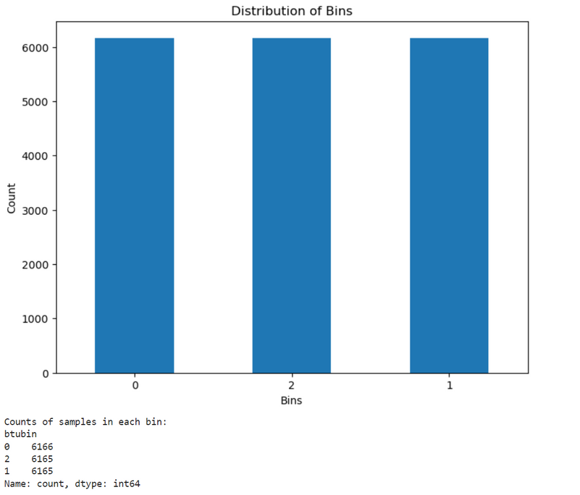
Binning the Data

Slide 13
ACCURACY = 58%
Logistic Regression
4
0.2
SAGA & LIBLINEAR
Attempts
Test Size
Optimizers

Slide 14
ACCURACY = 64%
Random Forest Classifier
3
300
RANDOM SEARCH & GRID SEARCH
Attempts
# of Decision Trees
Optimization Technique
Notes:
Used n-estimator of 100 - no significant change in R2 value when I fiddled with number of decision trees.
To optimize - looked at feature importance. Here, heating element, total energy consuming area, year constructed, type of housing unit, and total rooms had a higher importance. All other elements were dropped, by r2 value also dropped to .37

Slide 15

ENERGY CONSUMPTION
Target: Total BTU
Features: dwcycle, tvtype1, typetherm, lgtinled, smartmeter, solar, elecveh
Models: Linear Regression and Random Forest

Slide 16
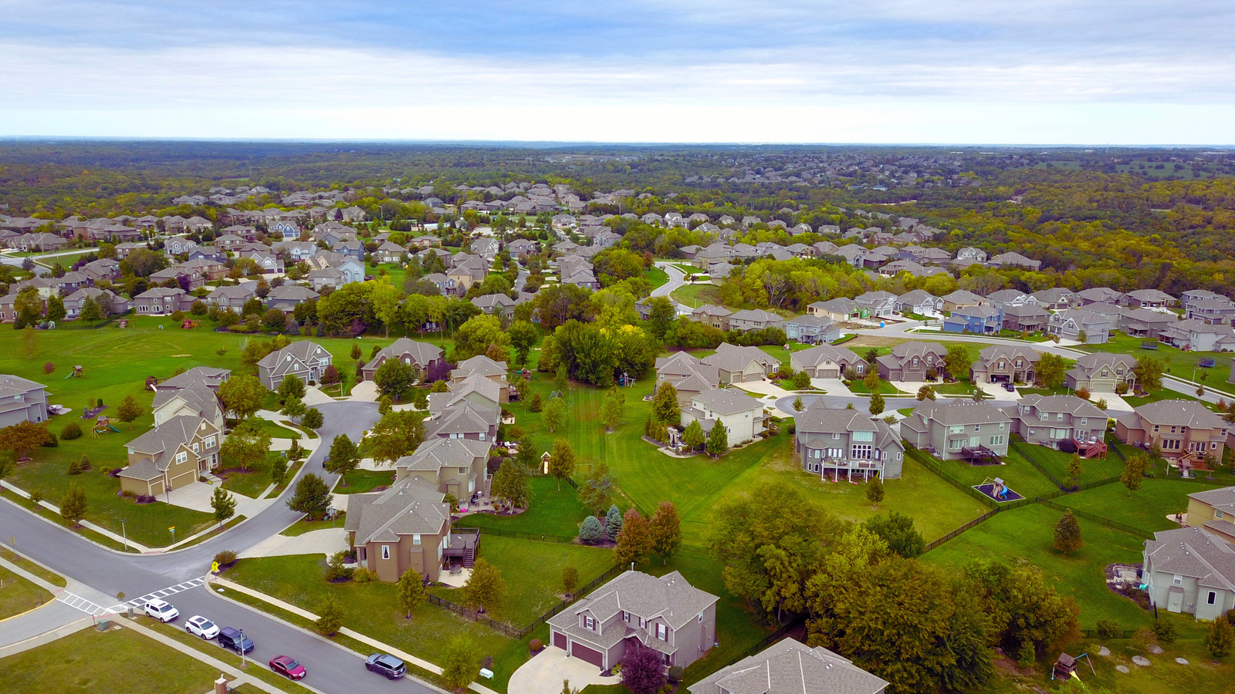
R2 = .57
Random Forest Regressor
2
100 and 110
.2
HYPERPARAMETER
Attempts
Number of Decision
Trees
Test Size
Optimizing Techniques

Slide 17
R2 = .69
Linear Regression Model
2
.1 AND .2
DATA SPLITTING PARAMETER
Attempts
Test Size
Optimizing Technique
Notes:
Used n-estimator of 100 - no significant change in R2 value when I fiddled with number of decision trees.
To optimize - looked at feature importance. Here, heating element, total energy consuming area, year constructed, type of housing unit, and total rooms had a higher importance. All other elements were dropped, by r2 value also dropped to .37

Slide 18
R2 = .79
Linear Regression Model
.2
FINAL
TARGET BINNING
Attempt
Test Size
Optimizing Techniques

Slide 19

REGIONAL INFORMATION
Target: totalbtu
Features: regionc, division, state_postal, ba_climate
Models: Random Forest, CatBooster, LightGBM, Keras Sequential nad Linear Regression

Slide 20
R2 = .11
Random Forest Regressor
2
100
Attempts
# of Decision Trees

Slide 21
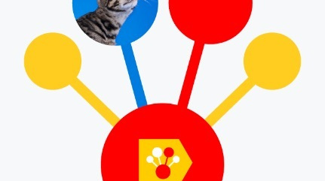
R2 = .11
CatBooster
1
1000
Attempt
# of iterations

Slide 22

R2 = 0.11
LightGBM
1
1000
GRADIENT BOOSTING DECISION TREE
Attempt
# of iterations
Optimizing Technique

Slide 23

ACCURACY =0.0%
Keras Sequential Model
3
HYPERPARAMETERS
/ ADAPTIVE MOMENT ESTIMATION
Attempts
Optimizing Technique

Slide 24

R2 =.75
Linear Regression Model
1
42
0.05
TARGET BINNING
Attempts
Optimizing Technique
Random State
Test Size

Slide 25
DEMOGRAPHICS
Target: Total BTU
Features: hhsex, hhage, employhh, education, sdescent, householder_race, nhsldmem, numchild, moneypy
Models: Linear Regression and Keras Sequential

Slide 26
R2 = N/A
Keras Sequential Model
1
78
Attempts
Random State

Slide 27

R2 = 0.79
Linear Regression Model
2
45
0.1
TARGET BINNING
Attempts
Optimizing Technique
Random State
Test Size

Slide 28

SUMMARY
Binning our target variables proved to be the most effective tool to create effective models.
This was true across all of our categories.

Slide 29
THANKS FOR LISTENING
Data Source: US Energy Information Administration's 2020 Residential Energy Consumption Survey
Group Members: Austin McConnell, Michelle di Sanctis, Joseph Anthony, Keisha Maldonado, Everette Gough and Joanna Lewis

